Slide 1
The Environmental Impact Of Software
Christian Abegg

Slide 2
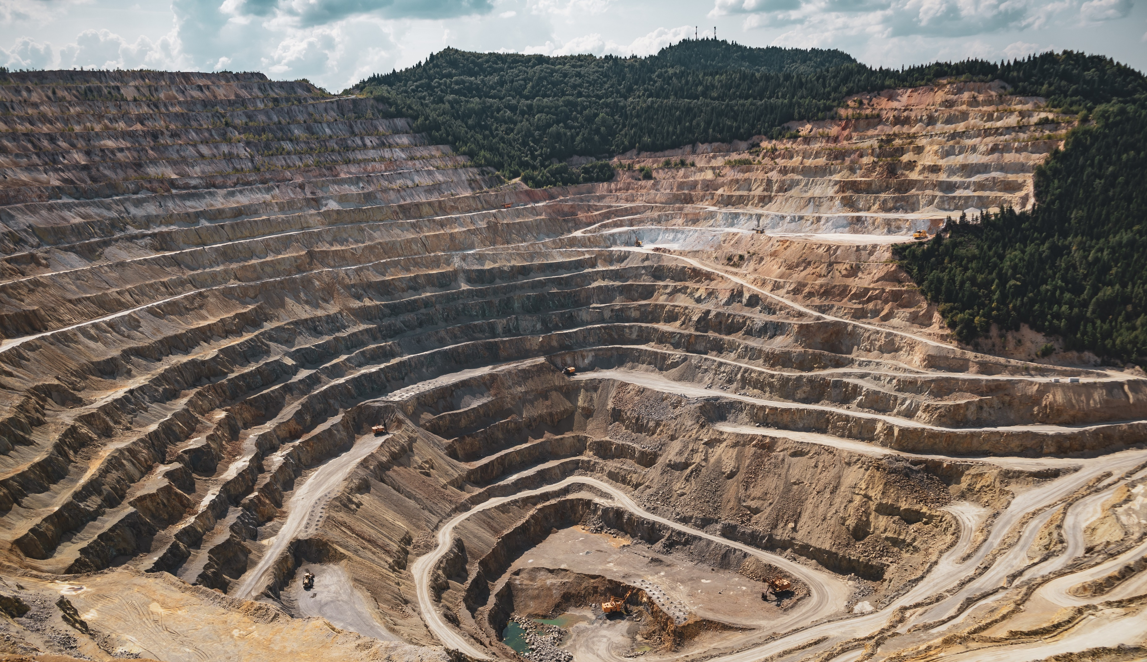
EXTRACTING RARE METALS
Pic: Vlad Chețan
Notes:
https://www.pexels.com/photo/mining-excavation-on-a-mountain-2892618/

Slide 3

FRESHWATER USAGE
Pic: Jill Burrow
Notes:
https://www.pexels.com/photo/rippling-water-surface-of-swimming-pool-6858676/

Slide 4
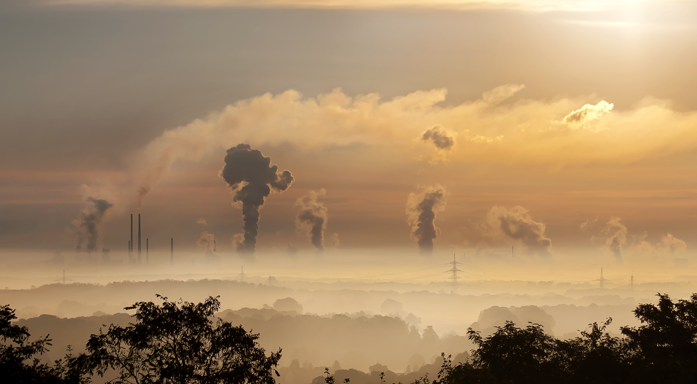
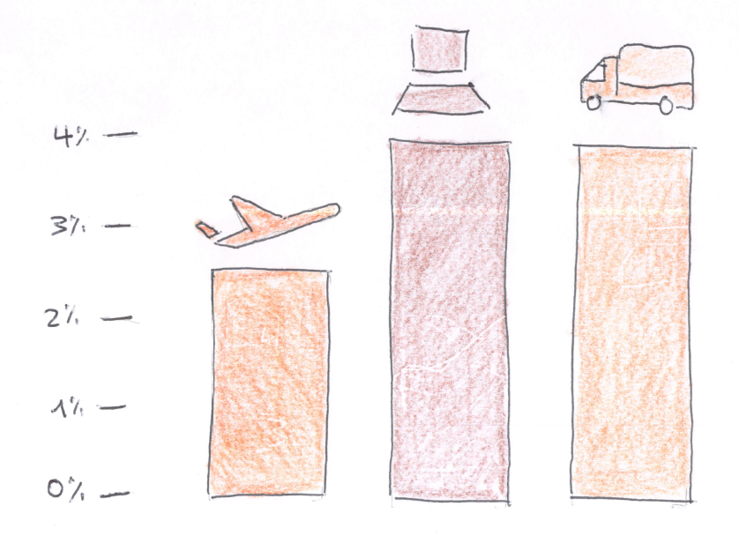
GREENHOUSE GAS EMISSIONS
Source: Digital Collage

Slide 5
GREENHOUSE GAS EMISSIONS
Notes:
https://www.pexels.com/photo/sky-clouds-building-industry-39553/

Slide 6
GREENHOUSE GAS EMISSIONS
Notes:
https://www.pexels.com/photo/sky-clouds-building-industry-39553/

Slide 7
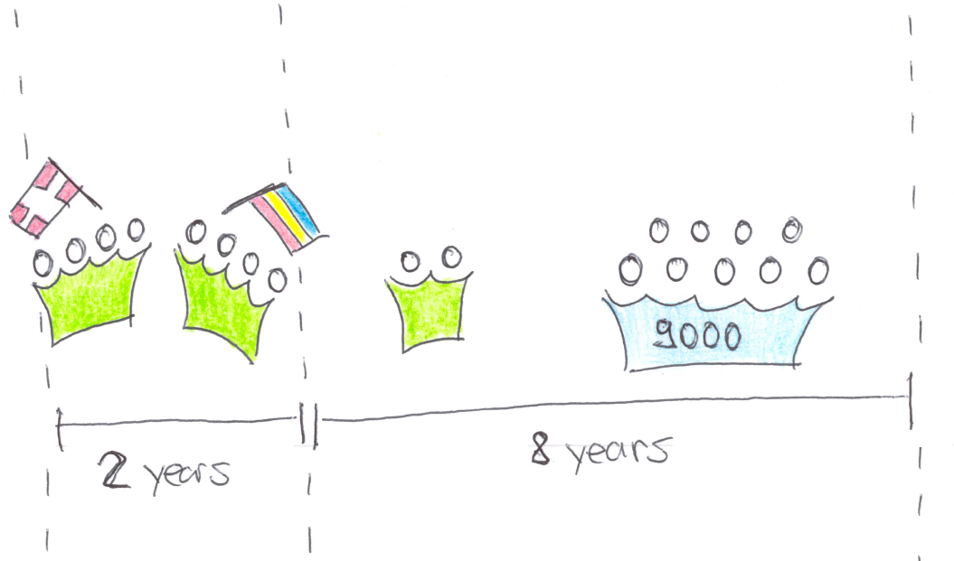
SIMULATED PROJECT

Slide 8
SIMULATED PROJECT

Slide 9
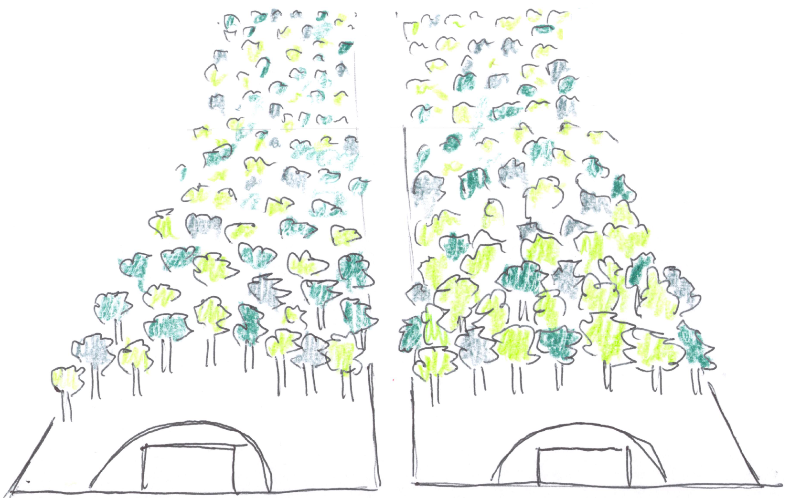
GREENHOUSE GAS EMISSIONS
Notes:
https://www.pexels.com/photo/sky-clouds-building-industry-39553/

Slide 10
Total emissions
25%

Slide 11
Work in the same country
25%

Slide 12
CUtting the number of cores and the memory in half
15%
25%

Slide 13
increase power usage EFFICIENCY by moving to a cloud + lower emission factor per kwh
8%

Slide 14
Decomission the 30% of zombie resources
7%

Slide 15
Switch off unused resources --------------------------------------------------------- USE CLOUD CI
8%
7%

Slide 16
Use a green energy product --------------------------------------------------------- increase home office
7%
7%

Slide 17
Eat Vegetarian lunches --------------------------------------------------------- extend hardware lifespan one year
6%
5%

Slide 18
Combined measures
75% reduced
25%

Slide 19
Combined effort
25%

Slide 20
github.com/abeggchr/ environmental-impact-estimator

